Slide 1
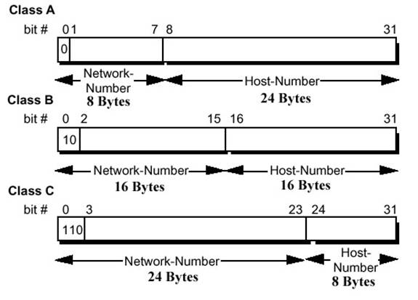

Slide 2
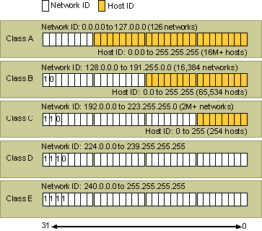

Slide 3
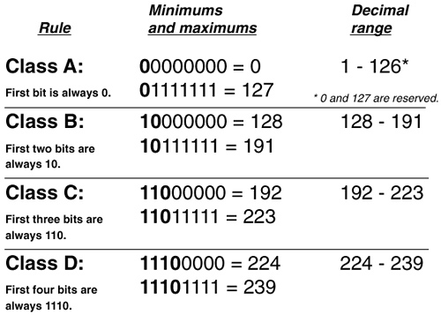

Slide 4
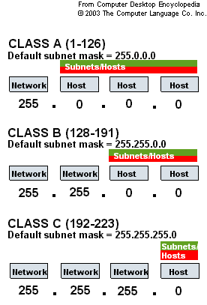

Slide 5
A 0
B 10
C 110
D 1110
E 1111
The six exceptions are:
Class A 0 (00000000) - no 0.x.x.x - can’t have all 0’s
Class A 10 (00001010) – no 10.x.x.x - the Class A “10” network is reserved for private use
Class A 127 – no 127.x.x.x - reserved for loopback.
Class B (1st octet = 172 OK - but the 2nd octet has an exception) – no 172.16.x.x
Class B (1st octet = 192 OK - but the 2nd octet has an exception) – no 192.168.x.x
Class E 255 (11111111) – can’t have all 1’s

Slide 6
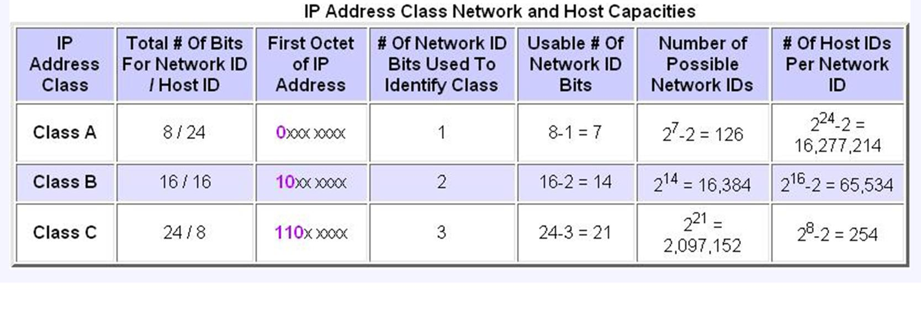

Slide 7
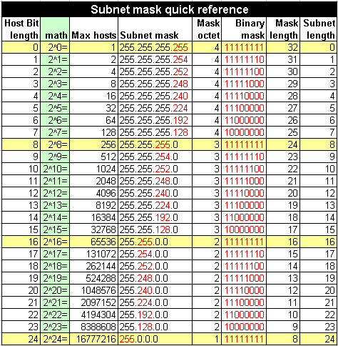

Slide 8
